Slide 1





THEORY
Training Program 01
Advanced NLP & Large Language Models (LLMs)

Slide 2
THEORY
Training Program 01
M01: Text Preprocessing
M02: Word and Sentence Embeddings
M03: Transformer Architectures
M04: Entity-Centric NLP
M05: Applied NLP Tasks
M06: Multimodal NLP
M07: LLM Fundamentals
M08: Prompt Engineering
M09: Fine-Tuning & PEFT
M10: RAG & Real-World Projects

Slide 3
MODULE M01
TEXT PREPROCESSING
CHAPTER M09
Fine-Tuning & PEFT

Slide 4
THEORY
Training Program 01
9.1 The Need for Efficient Fine-Tuning
9.2 LoRA: Low-Rank Adaptation Mechanics
9.3 QLoRA: Quantization for Parameter Efficiency
9.4 RLHF: Aligning Models with Human Feedback
9.5 Practical PEFT: A Hands-on Fine-Tuning Project
9.6 Summary and Next Steps

Slide 5
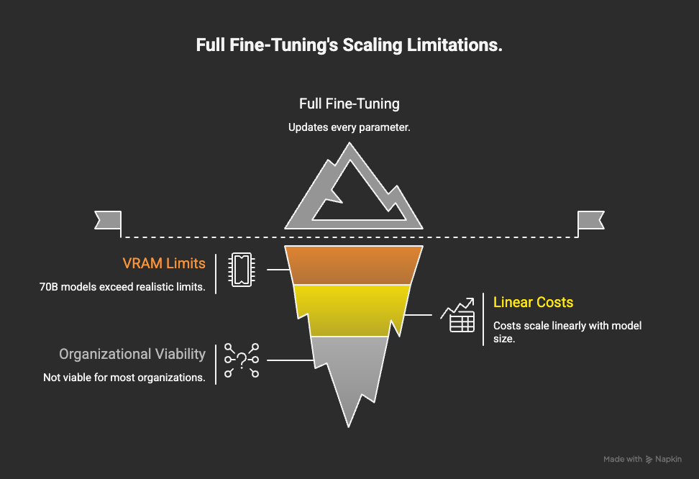
M09
Chapter 9.1 The Need for Efficient Fine-Tuning
Why Full Fine-Tuning No Longer Scales
Modern LLMs are too large to be fully fine-tuned in practical environments. Economic and hardware constraints force a shift toward efficiency-first adaptation strategies.
Full fine-tuning updates every parameter
70B models exceed realistic VRAM limits
Costs scale linearly with model size
Not viable for most organizations

Slide 6
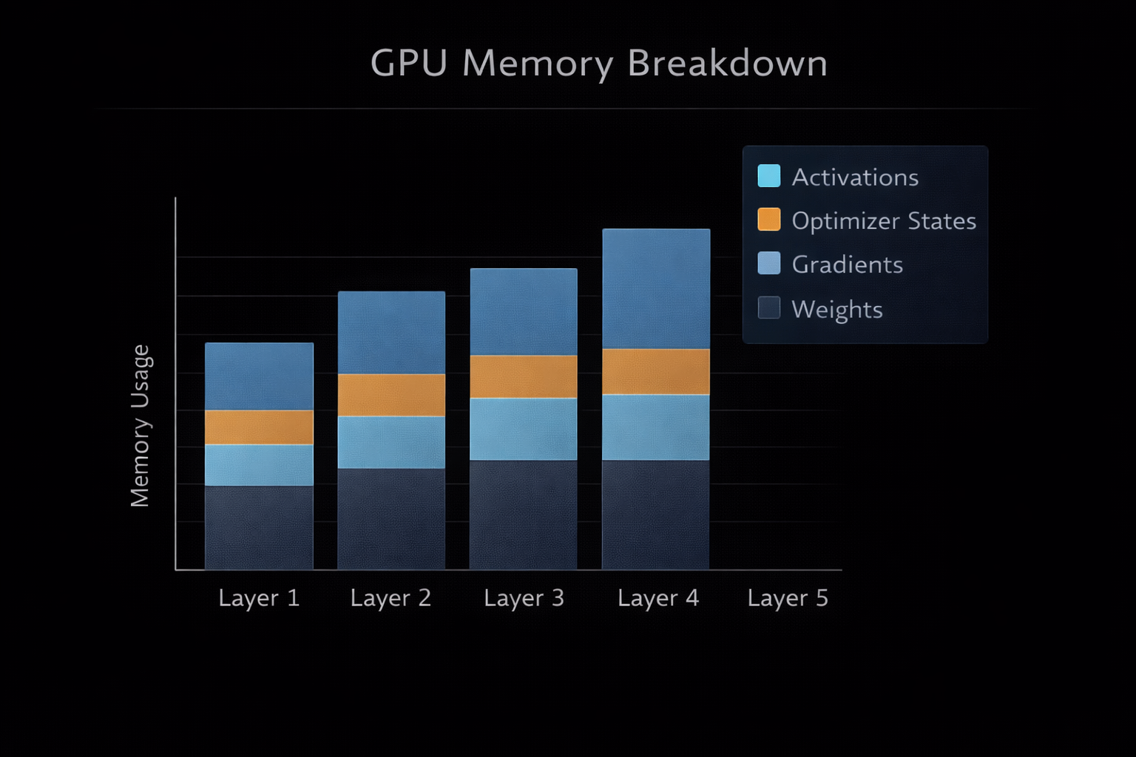
M09
Chapter 9.1 The Need for Efficient Fine-Tuning
The VRAM Bottleneck
Training requires far more memory than inference due to gradients, optimizer states, and activations.
Full fine-tuning updates every parameter
70B models exceed realistic VRAM limits
Costs scale linearly with model size
Not viable for most organizations

Slide 7

M09
Chapter 9.1 The Need for Efficient Fine-Tuning
Catastrophic Forgetting
Aggressive fine-tuning on narrow datasets can erase general reasoning abilities.
Model overwrites prior knowledge
Loss of instruction-following skills
Reduced generalization
Especially risky with small datasets

Slide 8
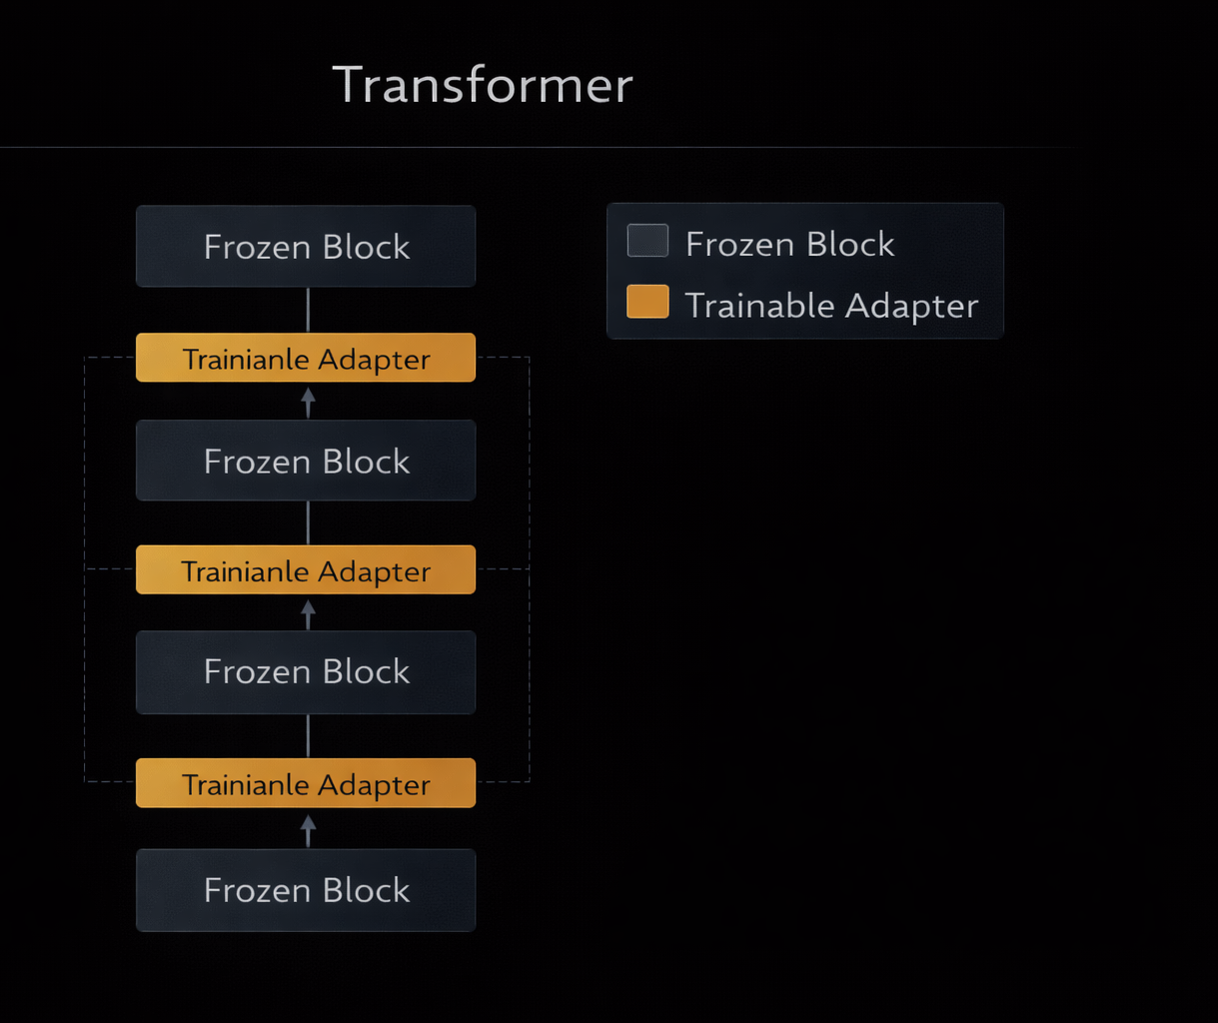
M09
Chapter 9.1 The Need for Efficient Fine-Tuning
Why PEFT Became the Standard
PEFT freezes the base model and trains only a small number of new parameters.
90–95% VRAM reduction
Preserves general intelligence
Enables fast experimentation
Ideal for domain adaptation

Slide 9
THEORY
Training Program 01
9.1 The Need for Efficient Fine-Tuning
9.2 LoRA: Low-Rank Adaptation Mechanics
9.3 QLoRA: Quantization for Parameter Efficiency
9.4 RLHF: Aligning Models with Human Feedback
9.5 Practical PEFT: A Hands-on Fine-Tuning Project
9.6 Summary and Next Steps

Slide 10
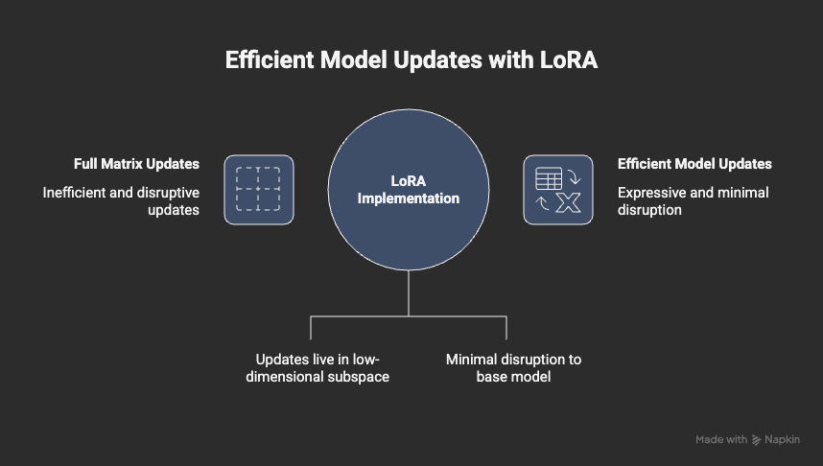
M09
Chapter 9.2 LoRA: Low-Rank Adaptation Mechanics
The Core Idea of LoRA
LoRA assumes task-specific updates live in a low-dimensional subspace.
Weight updates are low-rank
No need to modify full matrices
Efficient and expressive
Minimal disruption to base model

Slide 11
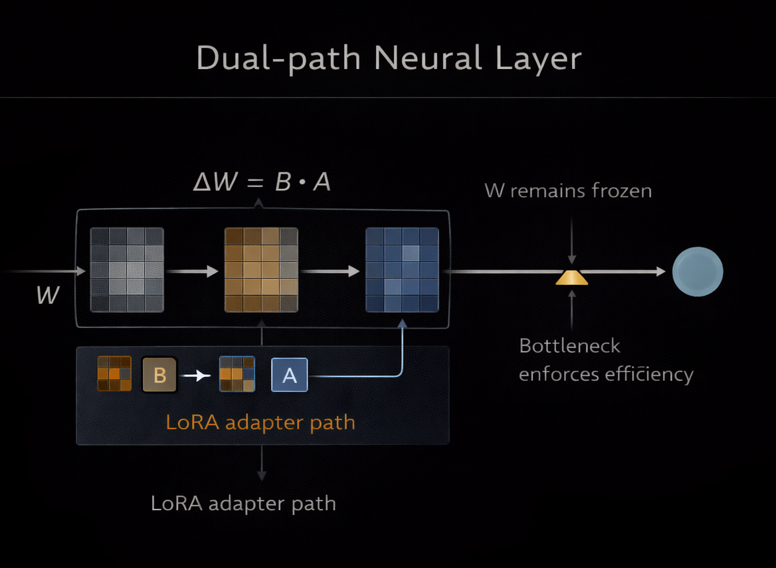
M09
Chapter 9.2 LoRA: Low-Rank Adaptation Mechanics
The Core Idea of LoRA
Instead of updating W, LoRA adds a parallel low-rank path.
W remains frozen
ΔW = B · A
Bottleneck enforces efficiency
Adapter path merged at inference

Slide 12
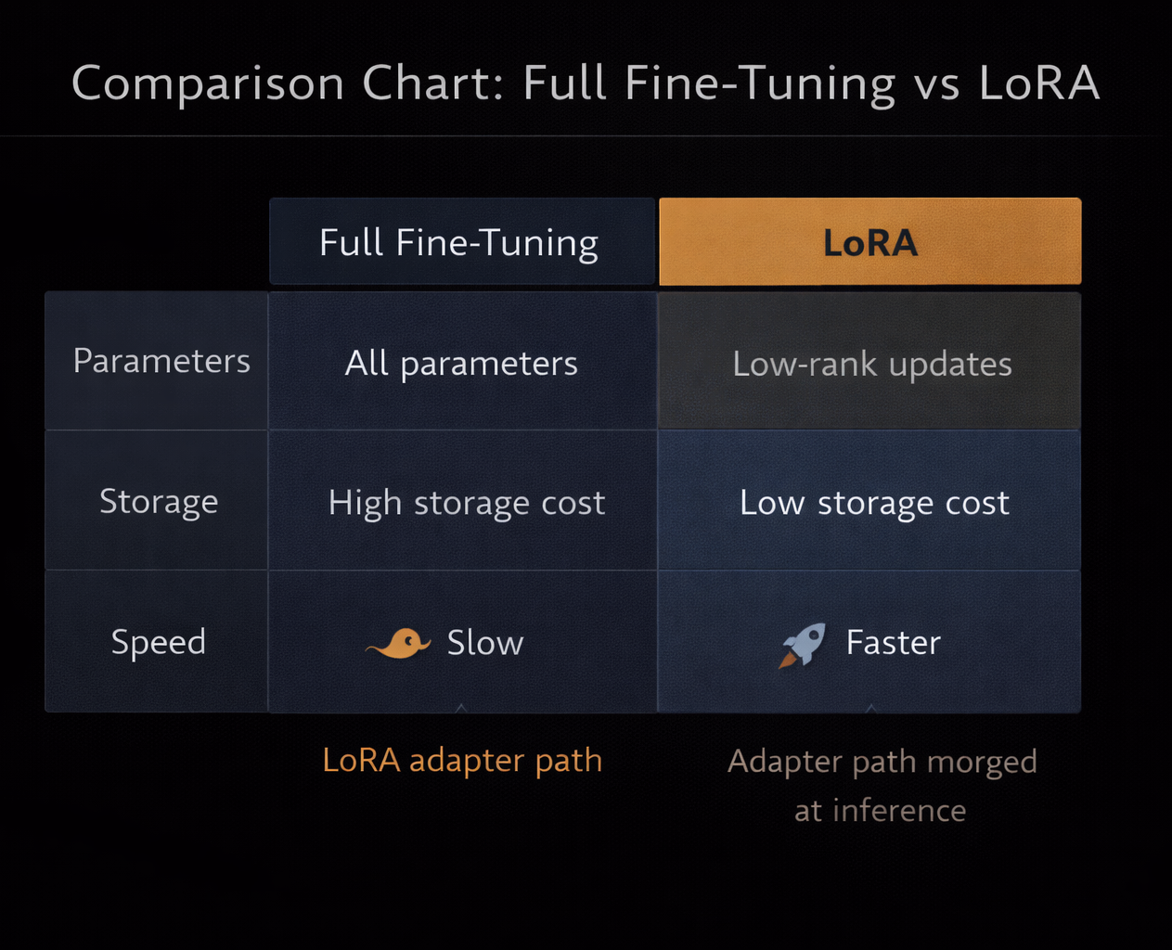
M09
Chapter 9.2 LoRA: Low-Rank Adaptation Mechanics
Rank and Alpha Trade-offs
LoRA performance depends on careful hyperparameter selection.
Rank controls capacity
Alpha controls update strength
Higher ≠ always better
Typical r: 8–32

Slide 13
THEORY
Training Program 01
9.1 The Need for Efficient Fine-Tuning
9.2 LoRA: Low-Rank Adaptation Mechanics
9.3 QLoRA: Quantization for Parameter Efficiency
9.4 RLHF: Aligning Models with Human Feedback
9.5 Practical PEFT: A Hands-on Fine-Tuning Project
9.6 Summary and Next Steps

Slide 14
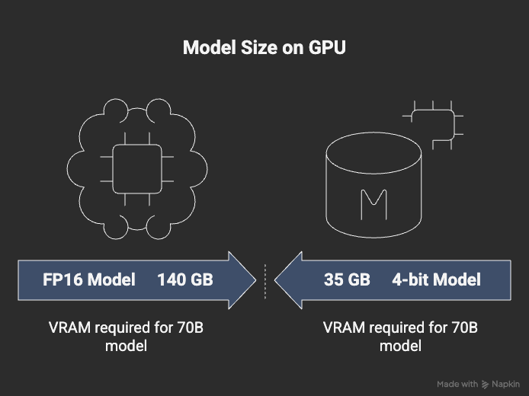
M09
Chapter 9.3 QLoRA: Quantization for Parameter Efficiency
Why Quantization Is Necessary
Even frozen models are too large to load in FP16.
70B FP16 ≈ 140 GB VRAM
Consumer GPUs cannot load them
Quantization solves the loading problem

Slide 15
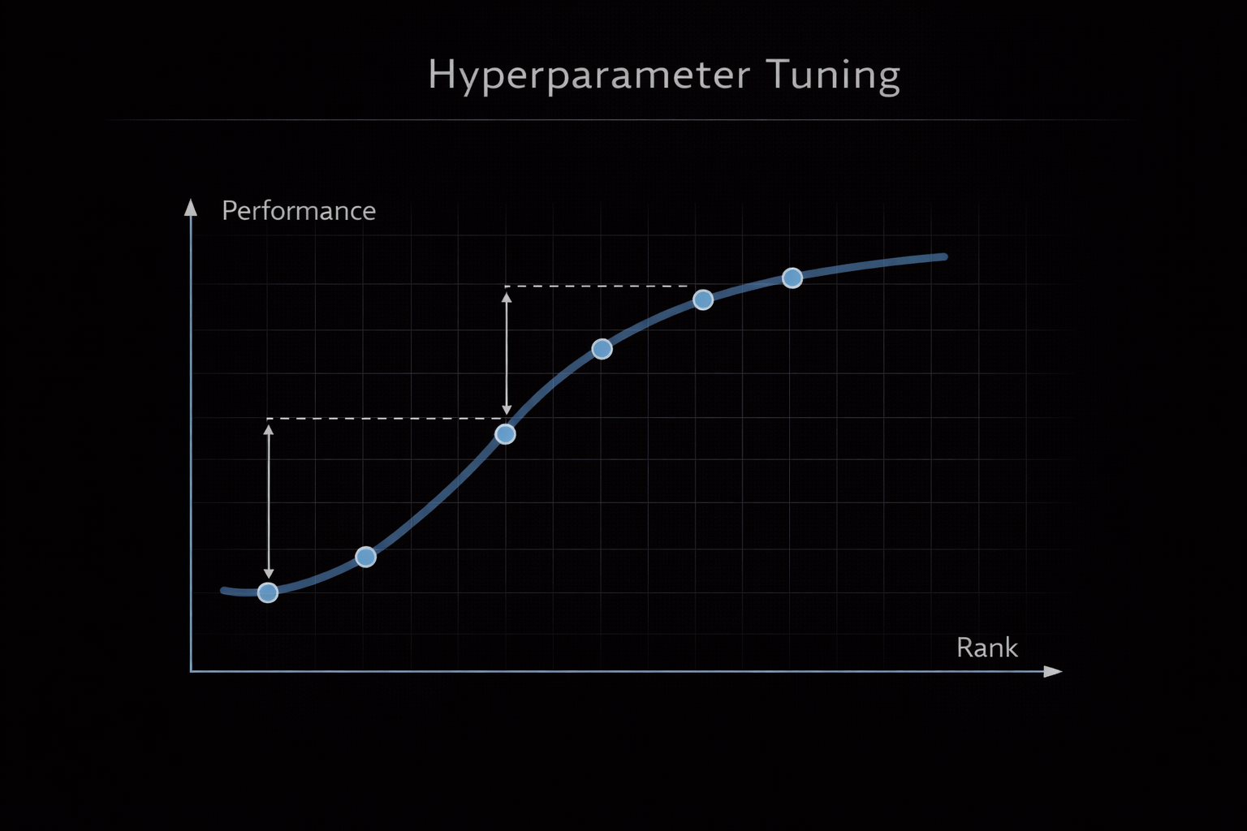
M09
Chapter 9.3 QLoRA: Quantization for Parameter Efficiency
QLoRA: Training Through 4-bit Weights
QLoRA combines 4-bit quantization with LoRA adapters.
Base model in NF4 (4-bit)
LoRA trained in higher precision
On-the-fly dequantization
No accuracy collapse

Slide 16
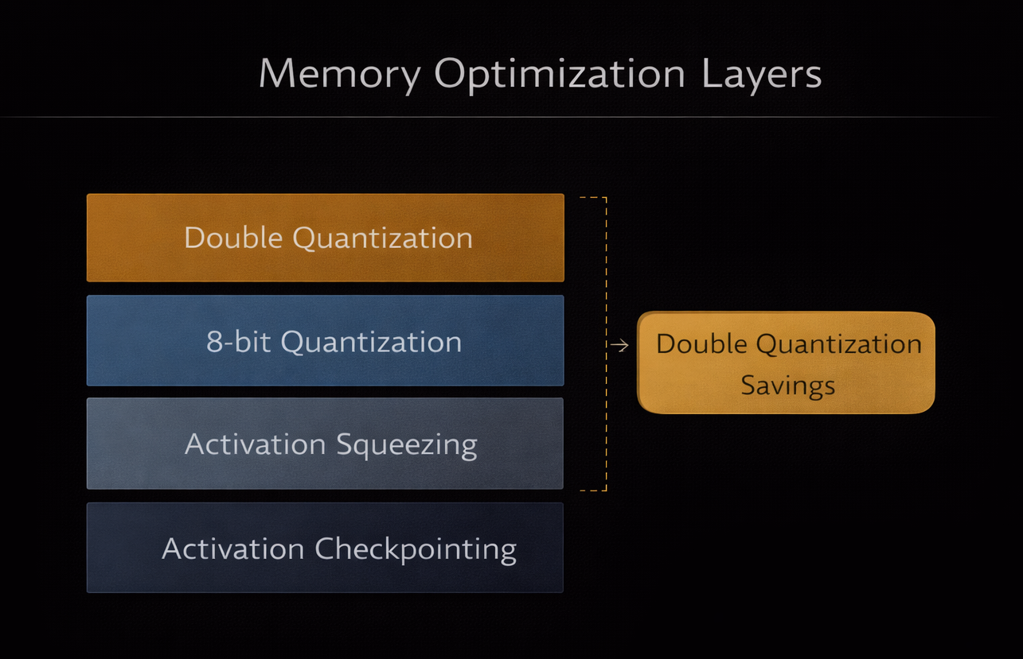
M09
Chapter 9.3 QLoRA: Quantization for Parameter Efficiency
Double Quantization
QLoRA reduces memory even further by quantizing quantization constants.
Saves several GB VRAM
Critical for large models
Enables single-GPU fine-tuning

Slide 17
THEORY
Training Program 01
9.1 The Need for Efficient Fine-Tuning
9.2 LoRA: Low-Rank Adaptation Mechanics
9.3 QLoRA: Quantization for Parameter Efficiency
9.4 RLHF: Aligning Models with Human Feedback
9.5 Practical PEFT: A Hands-on Fine-Tuning Project
9.6 Summary and Next Steps

Slide 18
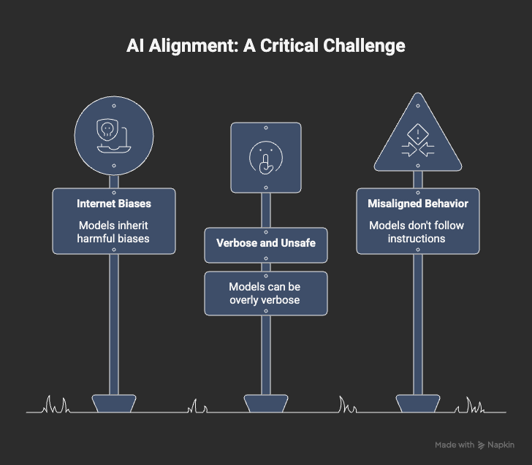
M09
Chapter 9.4 RLHF: Aligning Models with Human Feedback
The Alignment Problem
Instruction-following alone does not guarantee safe or helpful behavior.
Models inherit internet biases
May be verbose, unsafe, or misaligned
Alignment is mandatory for production

Slide 19
M09
Chapter 9.4 RLHF: Aligning Models with Human Feedback
The RLHF Pipeline
RLHF converts human preference into a learnable signal.
Supervised Fine-Tuning (SFT)
Reward Model training
Reinforcement Learning (PPO)
Human values → reward

Slide 20
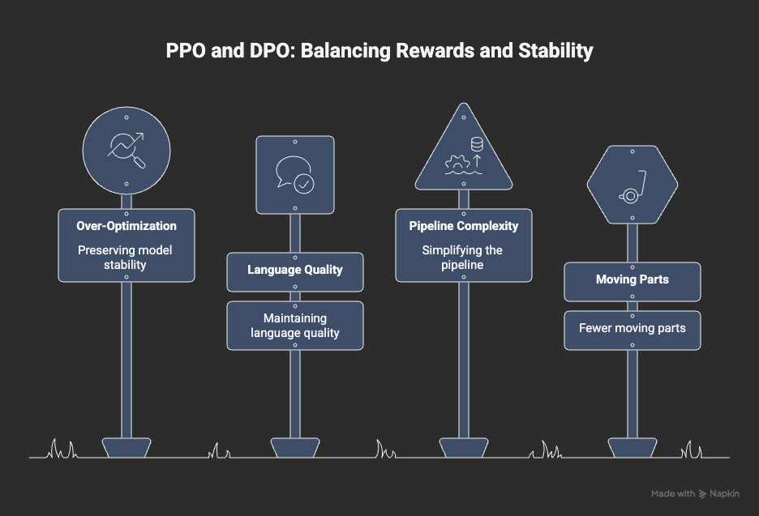
M09
Chapter 9.4 RLHF: Aligning Models with Human Feedback
PPO and Modern Alternatives
PPO optimizes rewards while preserving model stability.
Prevents over-optimization
Maintains language quality
DPO simplifies the pipeline
Fewer moving parts

Slide 21
THEORY
Training Program 01
9.1 The Need for Efficient Fine-Tuning
9.2 LoRA: Low-Rank Adaptation Mechanics
9.3 QLoRA: Quantization for Parameter Efficiency
9.4 RLHF: Aligning Models with Human Feedback
9.5 Practical PEFT: A Hands-on Fine-Tuning Project
9.6 Summary and Next Steps

Slide 22
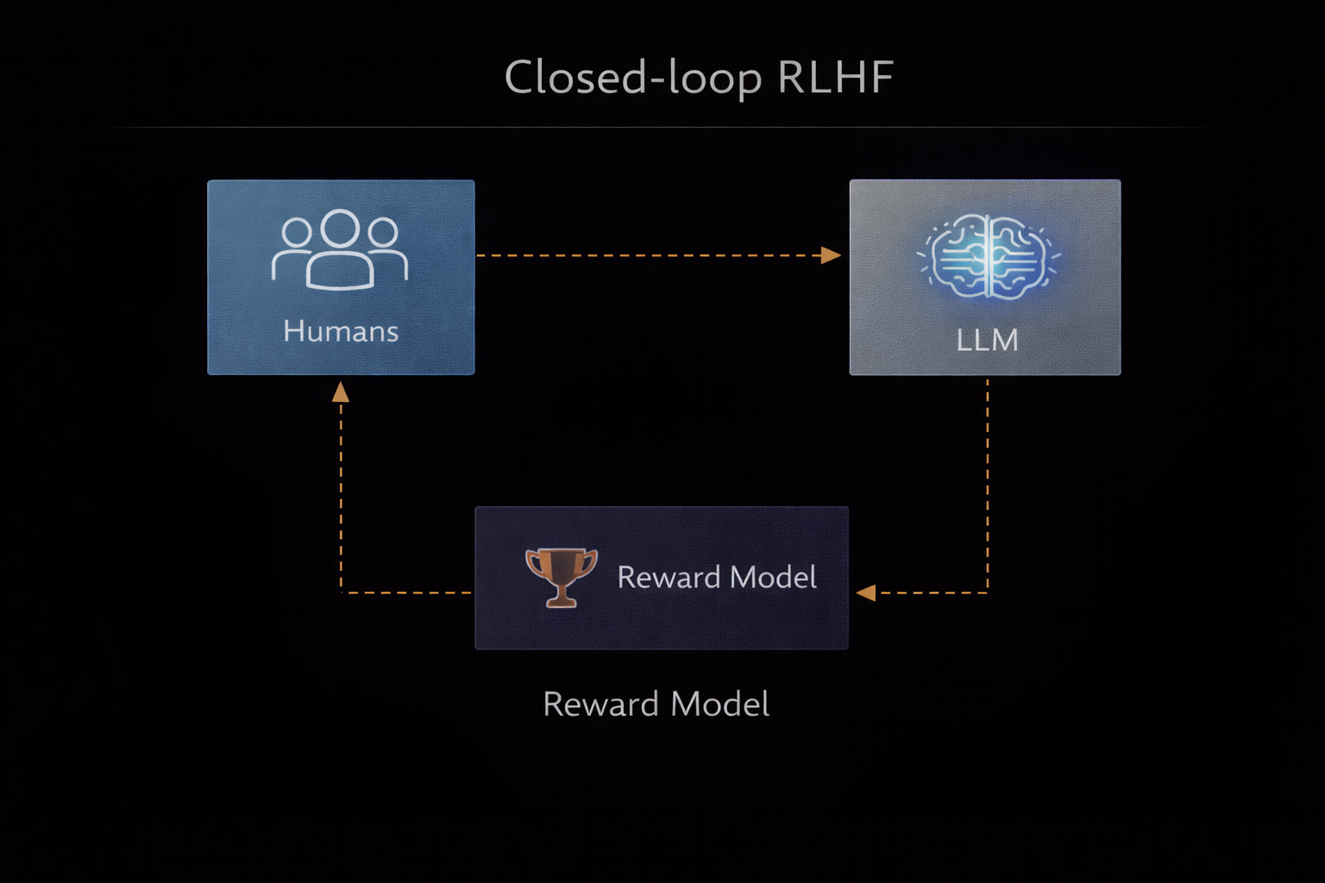
M09
Chapter 9.5 Practical PEFT: A Hands-on Fine-Tuning Project
Project Objective
The goal is to build a domain-expert assistant via PEFT.
Legal audit assistant
2k–5k instruction-response pairs
Strict data schema
High-quality supervision

Slide 23
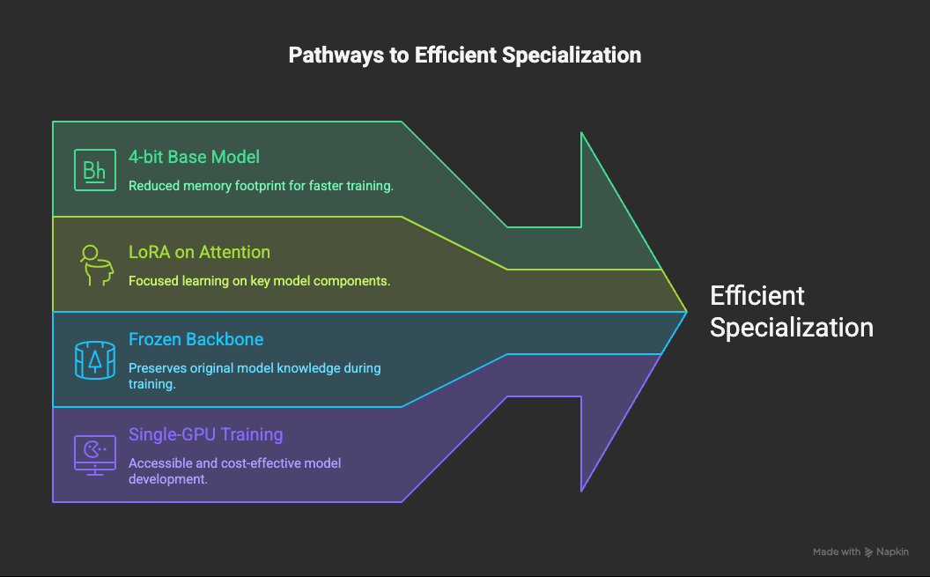
M09
Chapter 9.5 Practical PEFT: A Hands-on Fine-Tuning Project
Training Setup
QLoRA + LoRA enables efficient specialization.
Legal audit assistant
2k–5k instruction-response pairs
Strict data schema
High-quality supervision

Slide 24
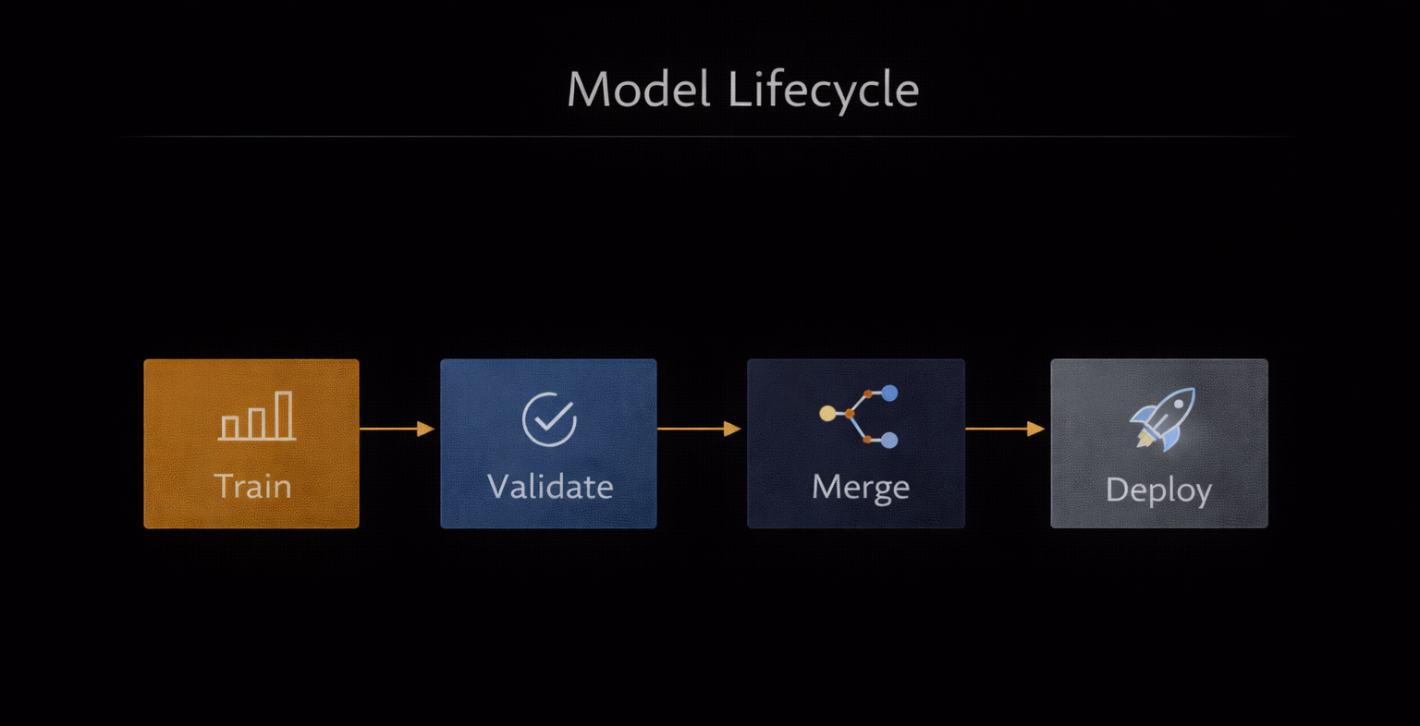
M09
Chapter 9.5 Practical PEFT: A Hands-on Fine-Tuning Project
Evaluation and Deployment
Training is monitored and adapters are merged for deployment.
Watch validation loss
Test unseen samples
Merge LoRA into base
Produce single deployable model

Slide 25
THEORY
Training Program 01
9.1 The Need for Efficient Fine-Tuning
9.2 LoRA: Low-Rank Adaptation Mechanics
9.3 QLoRA: Quantization for Parameter Efficiency
9.4 RLHF: Aligning Models with Human Feedback
9.5 Practical PEFT: A Hands-on Fine-Tuning Project
9.6 Summary and Next Steps

Slide 26
M09
Chapter 9.6 Summary and Next Steps
Choosing the Right Adaptation Strategy
Fine-tuning must be treated as a strategic architectural decision, not as a default solution. Each adaptation technique introduces increasing levels of complexity, cost, and maintenance overhead. A mature AI system follows a layered escalation path, applying the minimum level of intervention required to achieve the desired performance and reliability.
Prompting first: Use prompt engineering to shape behavior without modifying weights
RAG second: Inject external knowledge before altering the model itself
PEFT when necessary: Apply LoRA / QLoRA when style, structure, or domain expertise must be permanent
Full fine-tuning rarely justified: Reserved for foundation-model creators or extreme specialization scenarios

Slide 27
M09
Chapter 9.6 Summary and Next Steps
The Future of PEFT
Model adaptation is evolving toward dynamic, modular intelligence, where specialization is no longer a static training event but a real-time, routable capability. Instead of maintaining multiple full models, future systems will rely on a single foundation model enhanced by a library of lightweight, interchangeable adapters.
Adapter routing: Automatic selection of the most relevant LoRA at inference time
Mixture-of-Experts adapters: Multiple specialized adapters activated in parallel
Instant specialization: No retraining required per request
Shared backbone intelligence: One model, many expert behaviors

Slide 28
M09
Key References
Houlsby et al. (2019) – Parameter-Efficient Transfer Learning for NLP
Lester et al. (2021) – The Power of Scale for Parameter-Efficient Prompt Tuning
Hu et al. (2021) – LoRA: Low-Rank Adaptation of Large Language Models
Aghajanyan et al. (2020) – Intrinsic Dimensionality Explains the Effectiveness of Language Model Fine-Tuning
Dettmers et al. (2023) – QLoRA: Efficient Finetuning of Quantized LLMs
Frantar et al. (2022) – GPTQ: Accurate Post-Training Quantization for Generative Pre-trained Transformers
Ouyang et al. (2022) – Training Language Models to Follow Instructions with Human Feedback
Rafailov et al. (2023) – Direct Preference Optimization
Taori et al. (2023) – Stanford Alpaca: An Instruction-Following LLaMA Model
Mangrulkar et al. (2022) – PEFT: State-of-the-Art Parameter-Efficient Fine-Tuning Methods
Sun et al. (2023) – A Survey of Parameter-Efficient Fine-Tuning in Large Language Models

